Slide 1
A human tissue map of 5-hydroxymethylcytosines exhibits tissue specificity through gene and enhancer modulation
Group 7
Amisha Gupta (MT23225)
Diksha Kashyap (MT23228)
Milind Chauhan (MT23232)

Slide 2
Introduction-
5hmc is an epigenetic modification that is associated with gene transcription
It is frequently used to investigate dynamic DNA methylation conversion during mammalian development and in human diseases.
extensive 5hmC human tissue map obtained using 5hmC-Seal, a sensitive chemical labeling and pull-down method, followed by next-generation sequencing (NGS)
5hmc enriched regions were identified and evaluated for their regulatory potential and tissue specificity
Notes:
5hmC is an intermediate formed during demethylation of 5mC to form unmodified cytosine during activation of gene expression. Later it was known that 5hmC is itself a stable product.

Slide 3
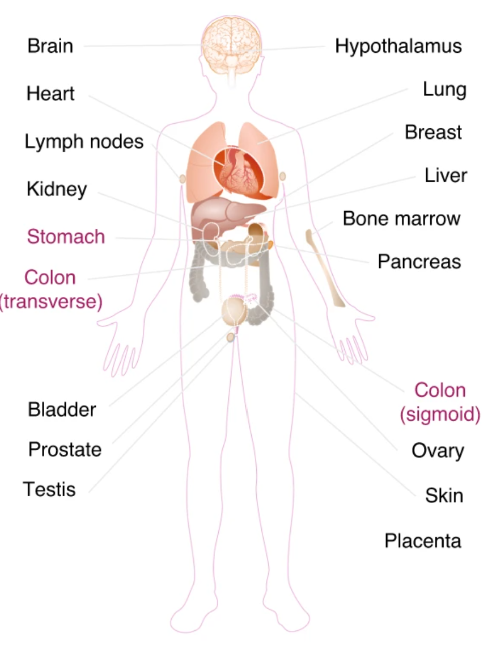
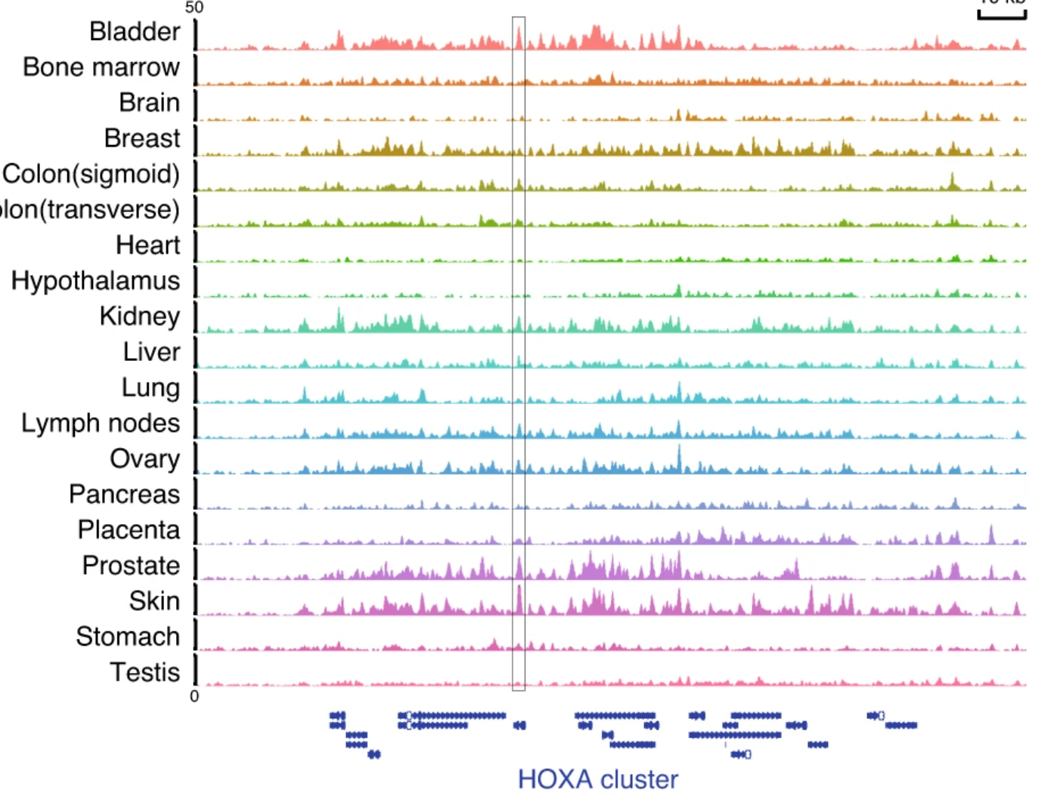
Genome wide 5hmc profile in 19 tissue types
Enrichment of 5hmc at HOXA gene cluster vary across tissue types.
Notes:
genome-wide 5hmc profiles in different human tissue types were developed
The authors were able to identify genome-wide 5hmC distributions that uniquely separates samples by tissue type. Further comparison of the 5hmC profiles with transcriptomes and histone modifications revealed that 5hmC is preferentially enriched on tissue-specific gene bodies and enhancers. Taken together, the results provide an extensive 5hmC map across diverse human tissue types that suggests a potential role of 5hmC in tissue-specific development
Enrichment of HOXA gene cluster vary across tissue types
Also, 5hmc peaks were found to be overrepresented at exons and promoters and underrepresented at intergenic regions in spite of different tissues the 5hmc loci were consistently distributed and preferential distribution across genic regions rather than intergenic regions, which again validates the hypothesis that 5hmc is a mark of active transcription and gene activation.
5hmc showed similar distribution patterns in all 8 tissue types when compared with distribution of different epigenetic modifications: i.e., highly enriched in regulatory chromatin states- h3k4me1 (which activates gene transcription), enhancer regions(enh, enhg), bivalent enhancer regions- responsible for embryonic development and lineage specification)

Slide 4
Objectives:
From the genome-wide map of 5hmc distribution, find common features and tissue specific features of 5hmc distribution in 19 human tissues.
To functionally profile each of the 5hmc samples
To find tissue specific motif regions.

Slide 5
Tools used
HOMER
Bowtie2
MACS2
Bedtools
Metascape
EnrichR
Great Gene Ontology
Notes:
HOMER - Annotation
Bowtie2 - Alignment
MACS2 - Peak calling
Bedtools - Sort and merge
Metascape - Pathway enrichment of common genes
Great Gene Ontology

Slide 6
Methodology
Downloaded 96 tissue specific narrow peak files.
GSE144530
Processing Raw Reads
Bowtie2
Samtools
MACS2
Bash and python scripts for automation
Tissue-wise Annotation using HOMER
Tissue-wise Motif analysis using HOMER
Distribution of peak counts across samples.
Pathway Enrichment of common genes using Metascape
5hmc deposition across different tissue.
Clustering using RNA-seq data
Pathway Enrichment of specific genes using Enrichr-KG
Pathway Enrichment Analysis using Metascape
Notes:
1. We downloaded 96 tissue specific narrow peak files provided in the paper (GSE144530). The samples included bladder, brain, colon, heart, hypothalamus etc.
2. We used bedtools to sort and merge the narrow peak files of the same tissues and then annotated the merged peaks using HOMER.
4. Based on the We identified 5hmC expressed genes
5. We performed t-SNE clustering on RNA-seq (RPKM values of tissues across 96 samples) data and observed samples from one tissue type were clustered together.
We examined 5hmc deposition across different tissues and we found a similar trend, 5hmc is deficient at TSS and enriched at promoters and gene bodies. 5hmc signals from Colon and stomach tissues showed a trend of lower levels relative to other tissues, which may be due to changes caused by the tumor present in adjacent tissue. 5hmc peaks were enriched at promoters suggesting a tight regulation of genomic distribution of 5hmc.

Slide 7
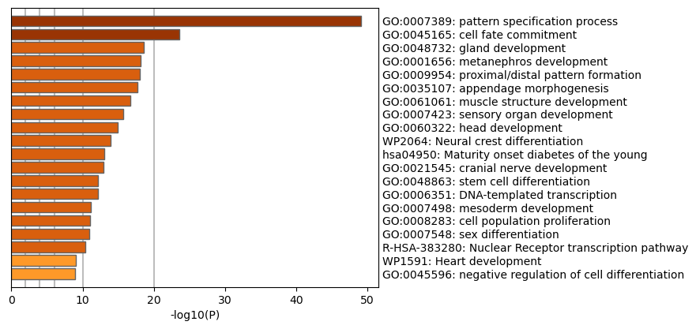
Pathway Enrichment Analysis
Notes:
Based on the 5hmC tissue specific modified genes we performed pathway enrichment analysis using Metascape.
We identified statistically enriched terms (ex. GO/KEGG etc.)
Stem Cell differentiation, embryonic dev and other tissue specific functions.
These pathway reflected tissue specific functions thereby highlighting the specificity

Slide 8
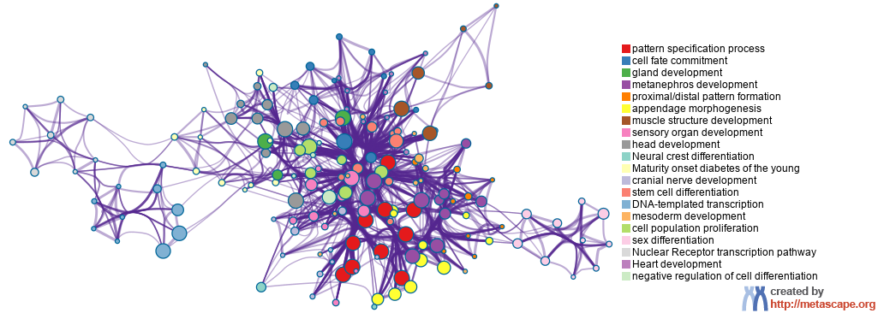
Notes:
We also got network layout

Slide 9
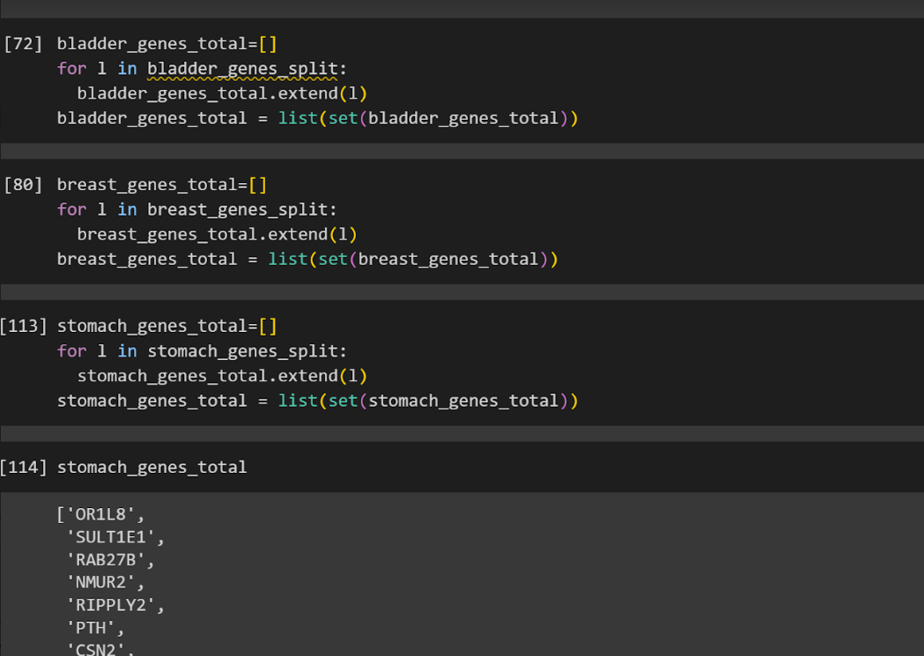
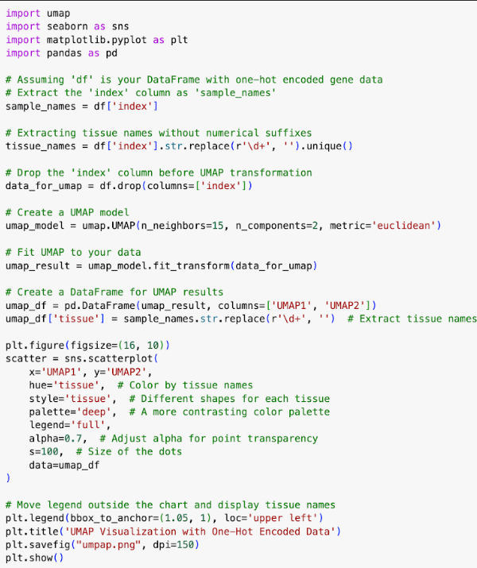
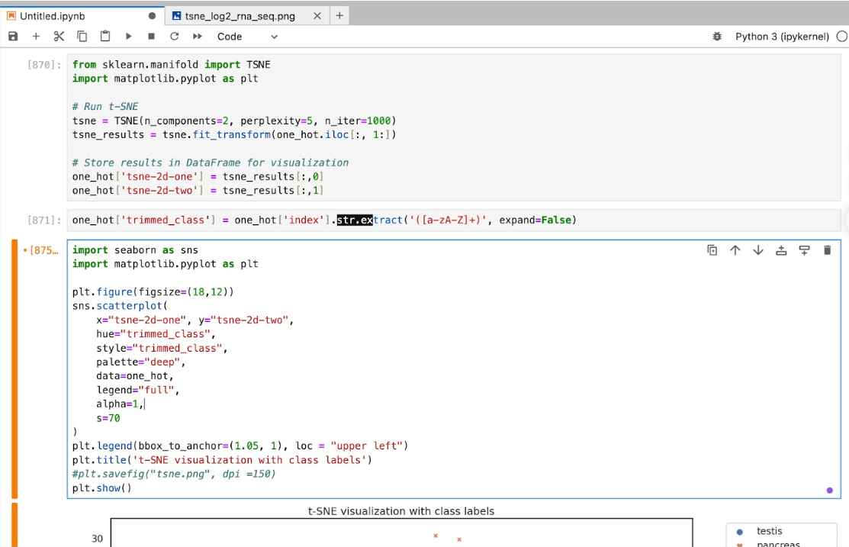
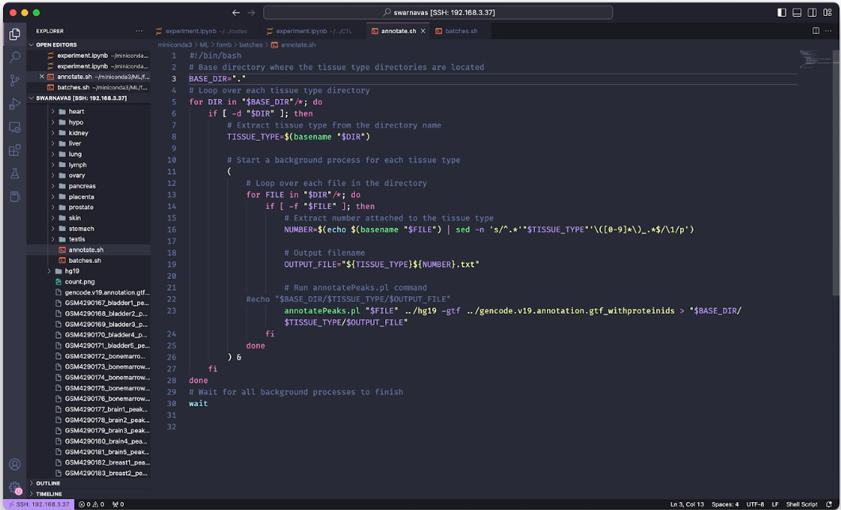

Slide 10
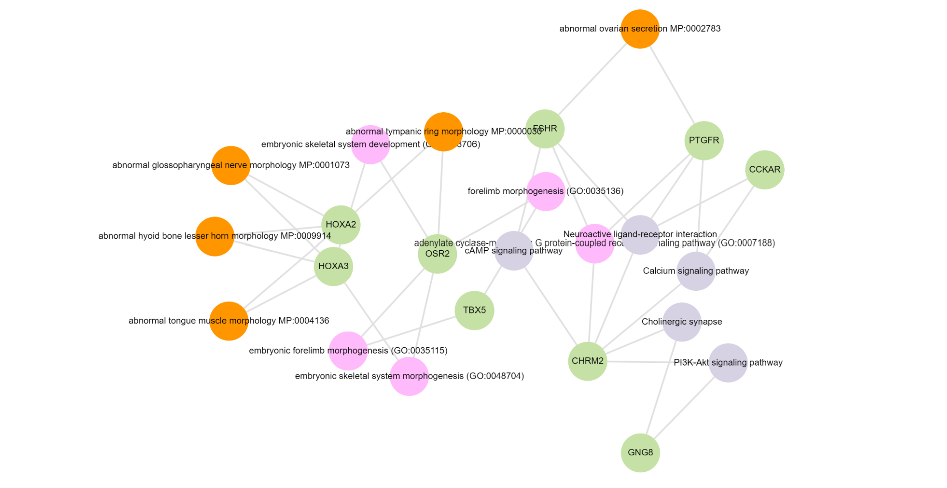
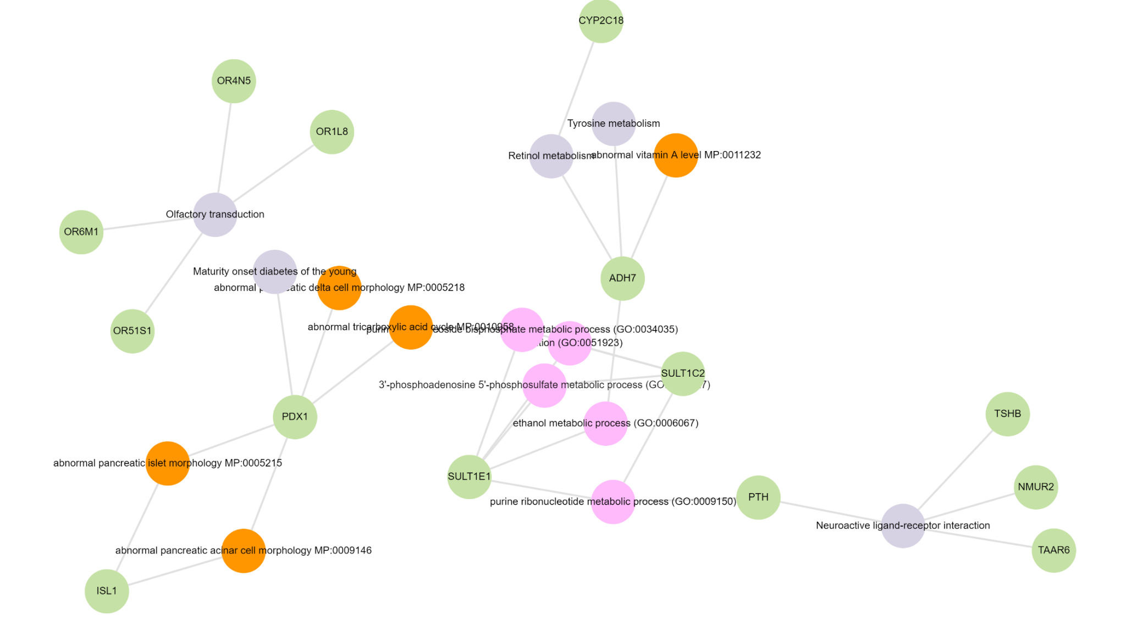
Bladder
Stomach

Slide 11
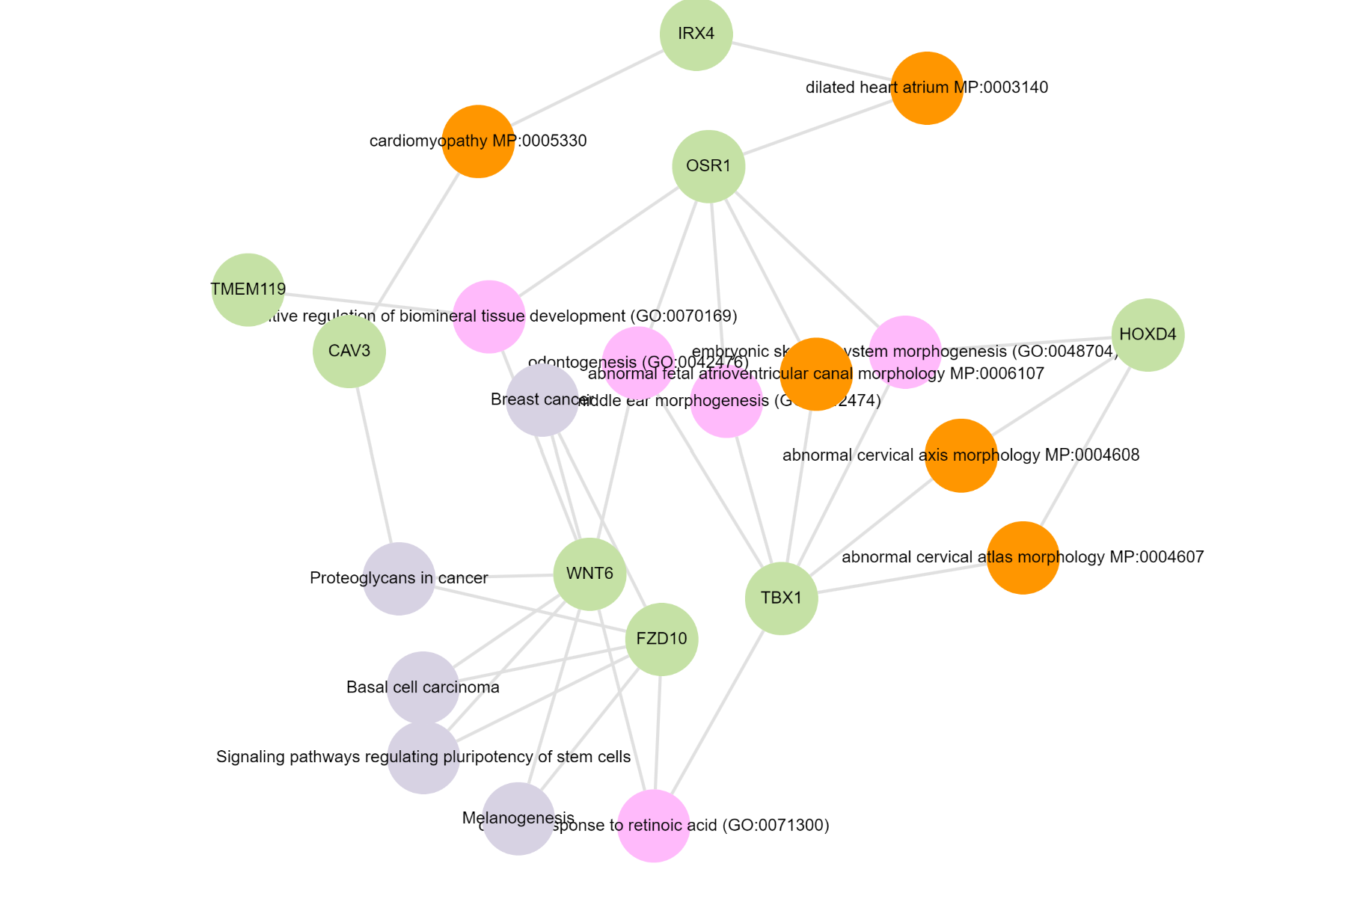
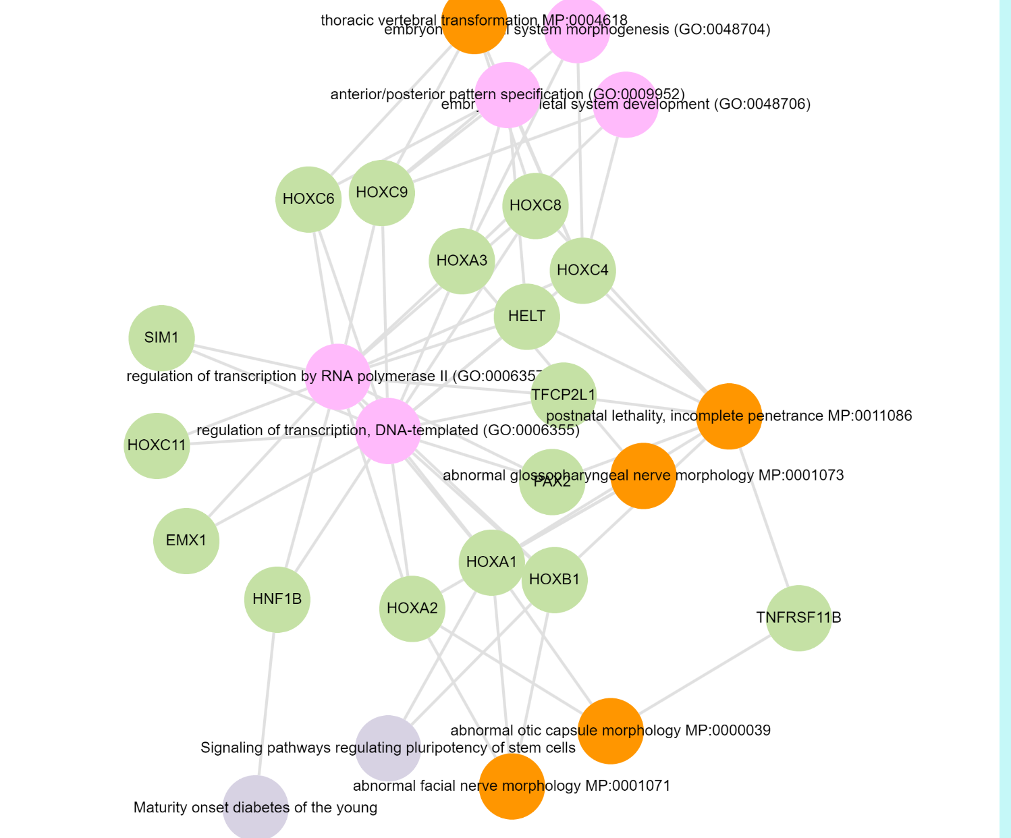
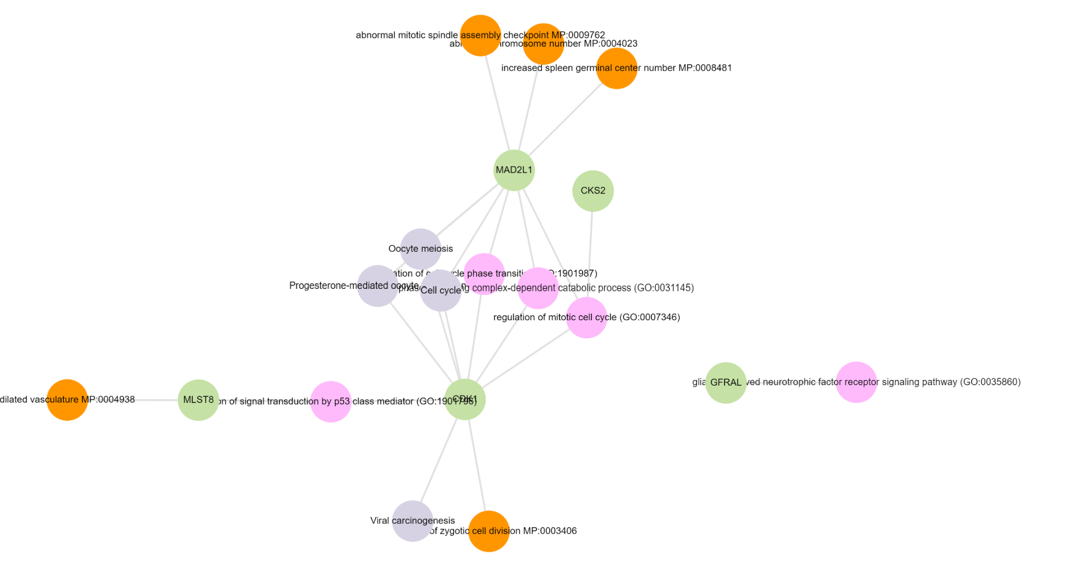
Kidney
Breast
Colon Sigmoid

Slide 12
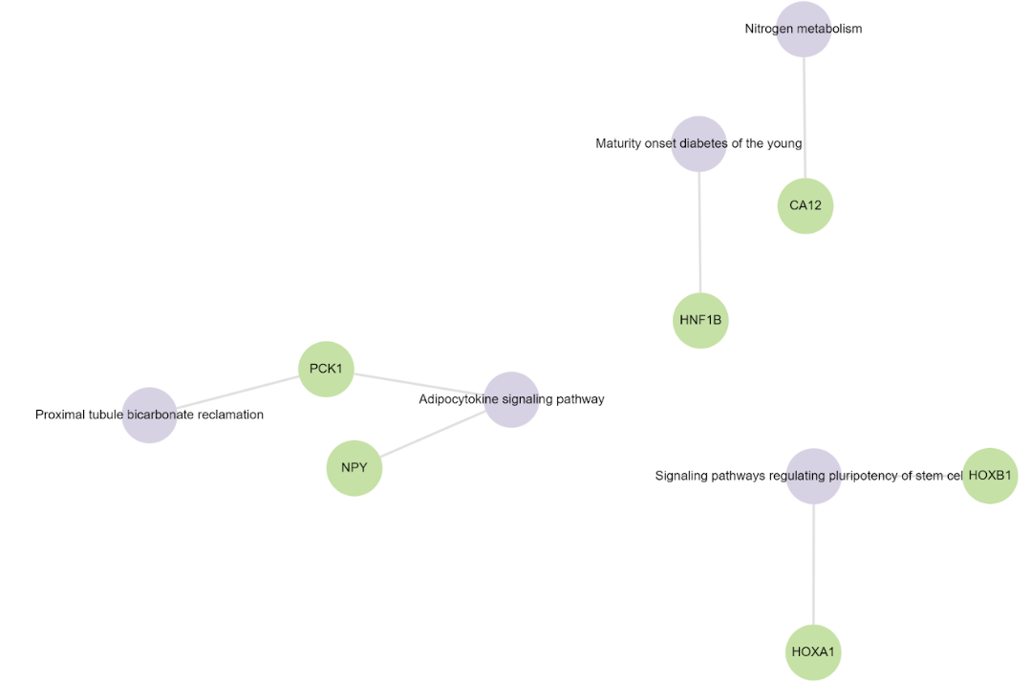
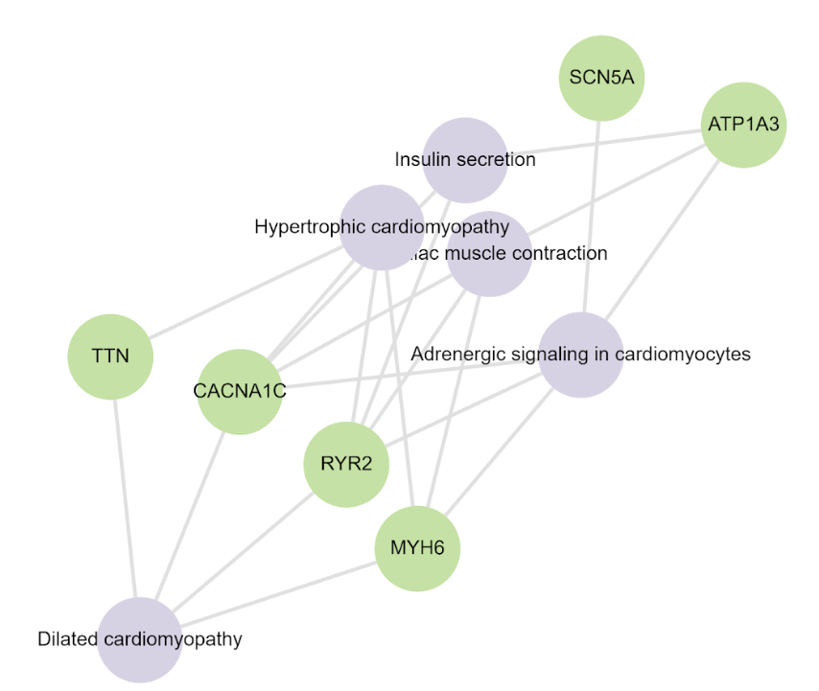
Kidney
Heart

Slide 13
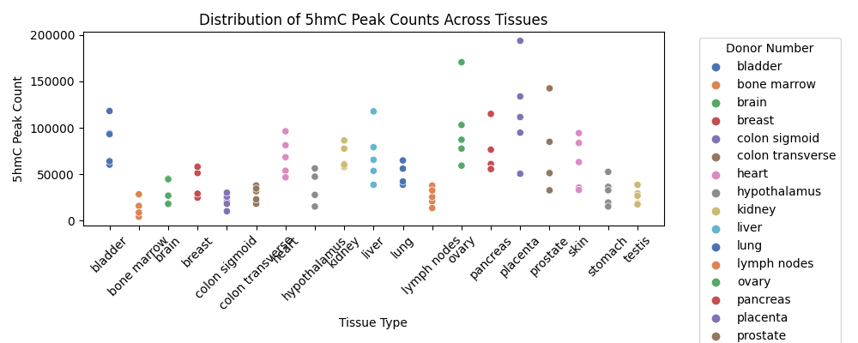
Notes:
We plotted peak numbers within different tissue samples and we can see the following trend
Highest – Placenta
Lowest – Bone Marrow
Placenta showed highest 5hmC modification, highlighting that 5hmC plays a role in early stage development.

Slide 14




Motifs
Bladder
Bone Marrow
Colon Trans
Heart
Notes:
CG motif was the most significant motif across the 5hmC across all tissues.

Slide 15
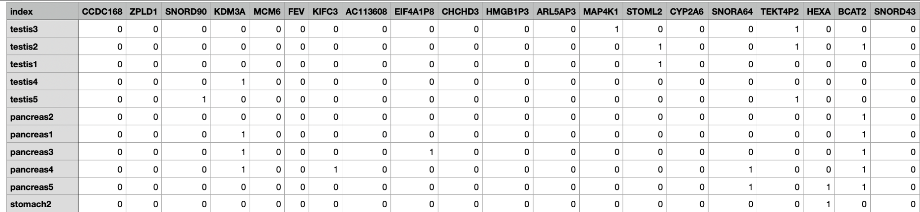
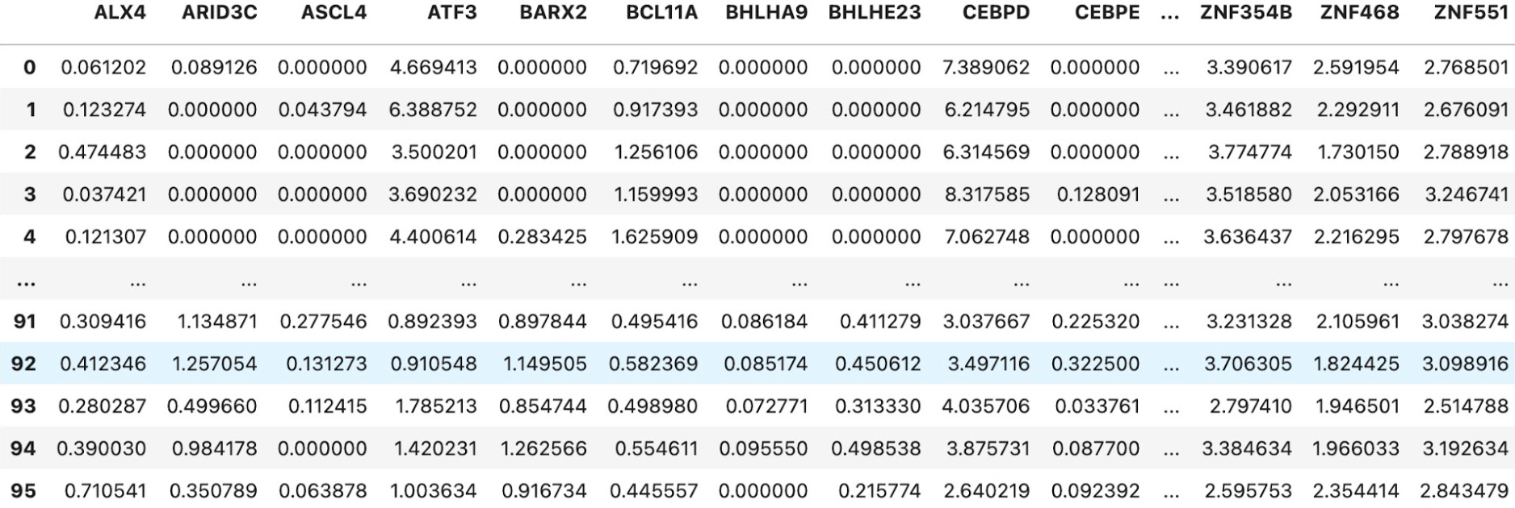

Slide 16
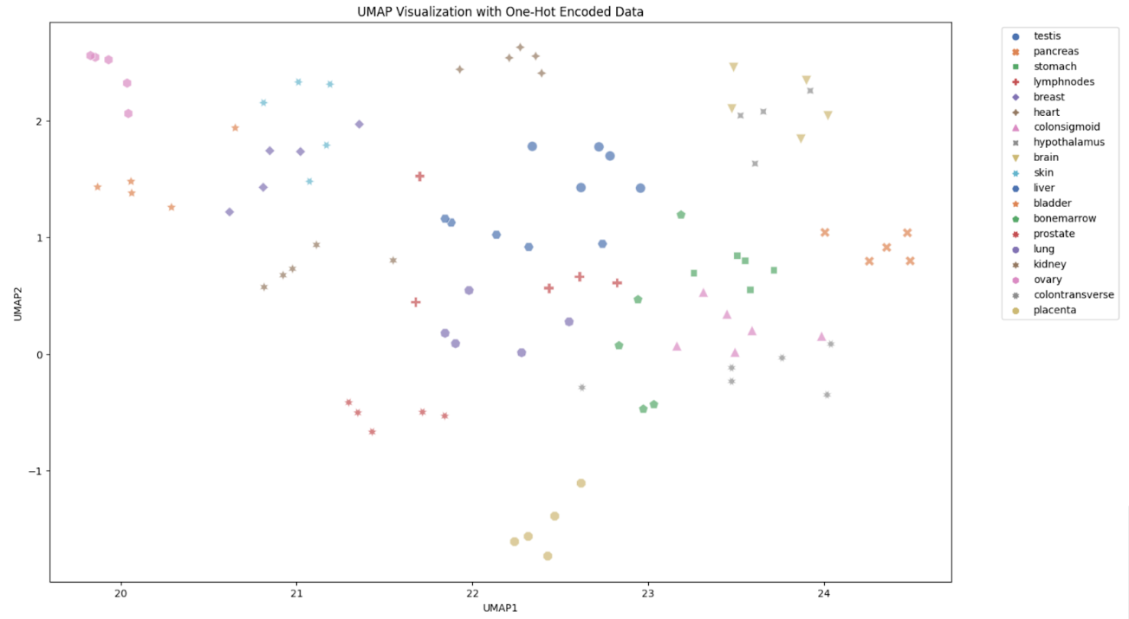

Slide 17
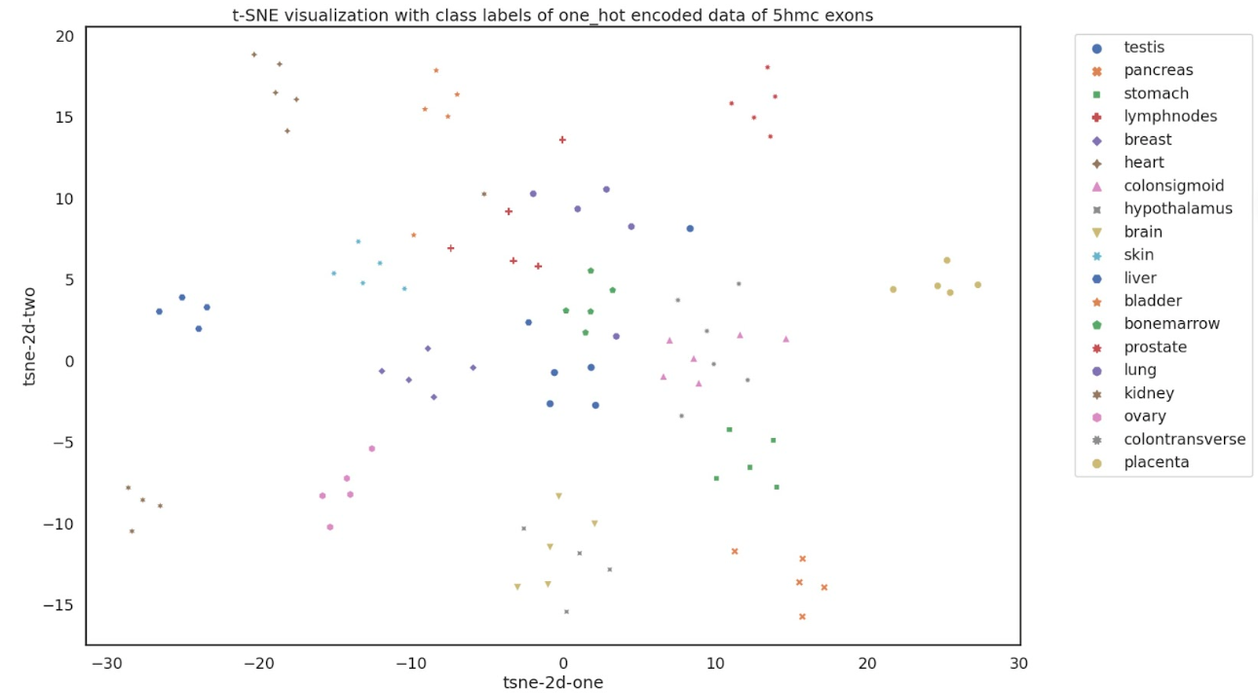

Slide 18
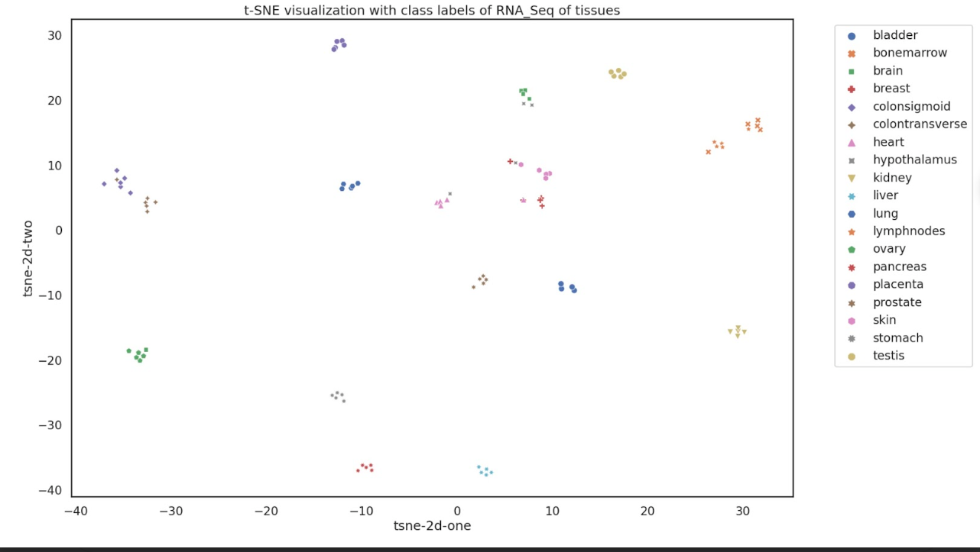

Slide 19
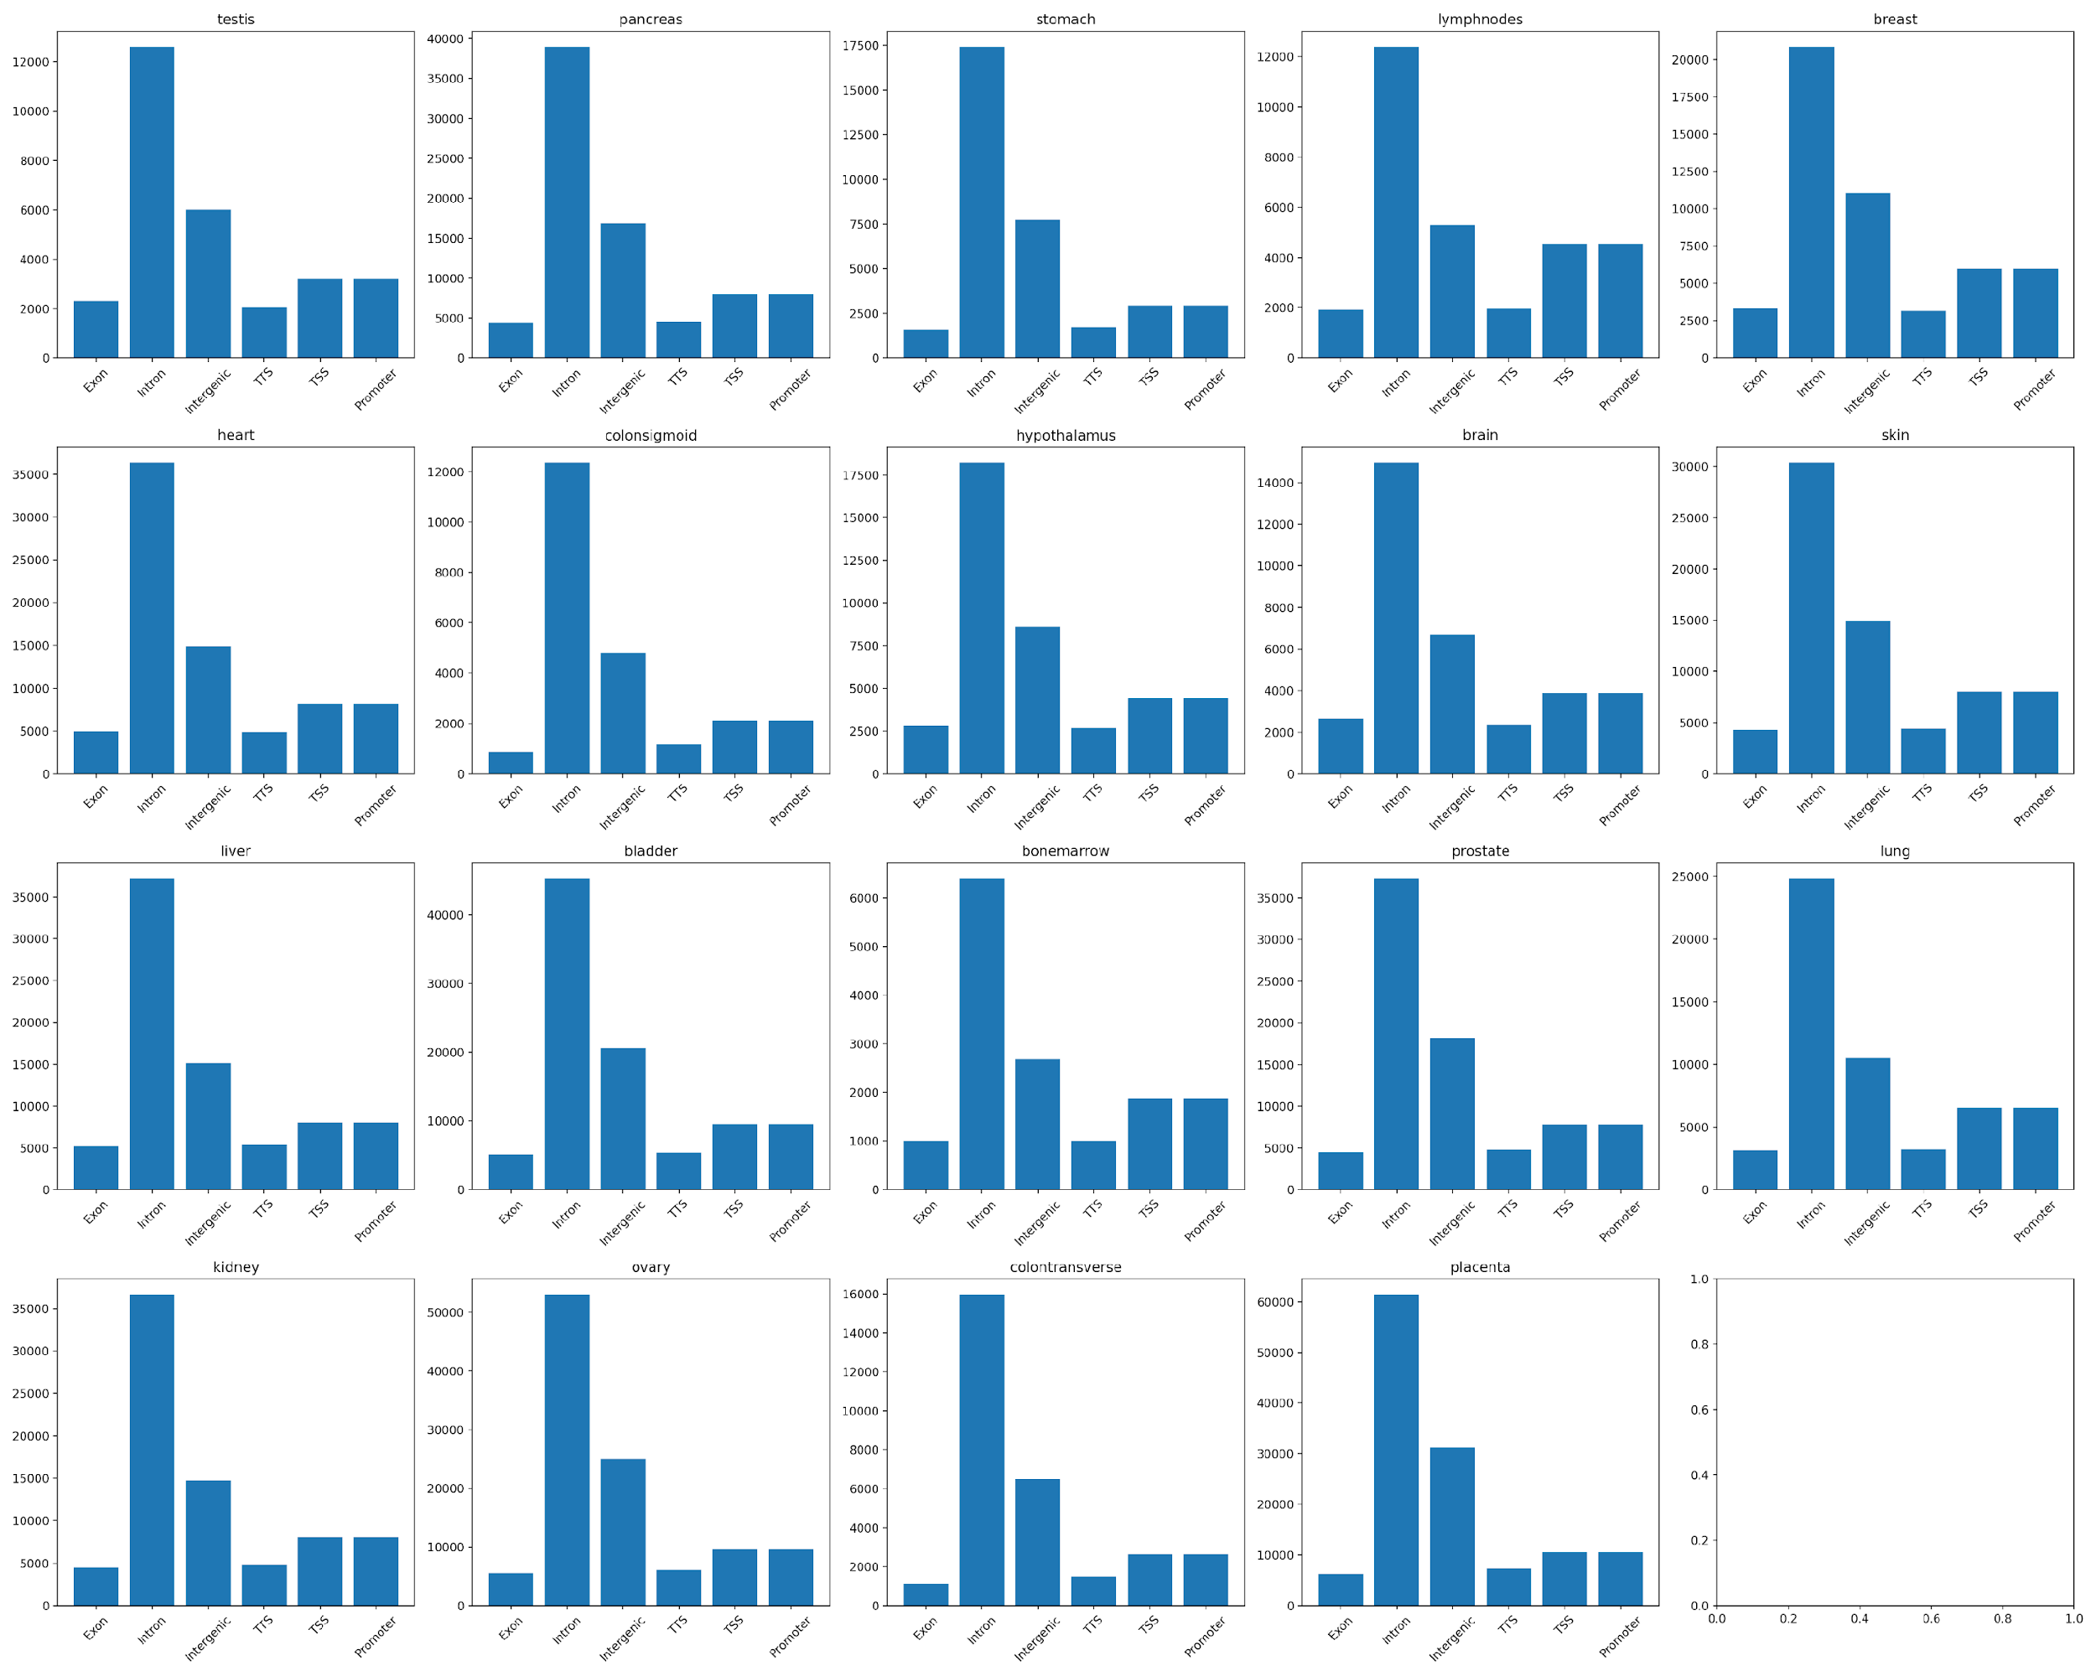
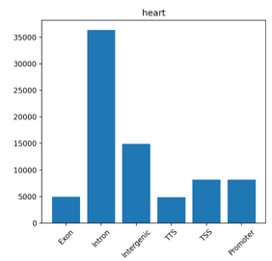

Slide 20
Purpose of performing TSS distance analysis
•Spatial Relationship Clarification: TSS distance analysis aids in clarifying how epigenetic modifications, such as 5hmC, are distributed concerning gene transcription start sites. This spatial understanding is vital for unraveling the regulatory dynamics of these modifications.
•Insights into Regulatory Mechanisms: By identifying preferential binding locations, TSS distance analysis provides insights into the potential regulatory impact of epigenetic modifications. This is particularly relevant for understanding how 5hmC may influence gene expression, with tissue-specific patterns adding an additional layer of complexity to regulatory mechanisms.

Slide 21
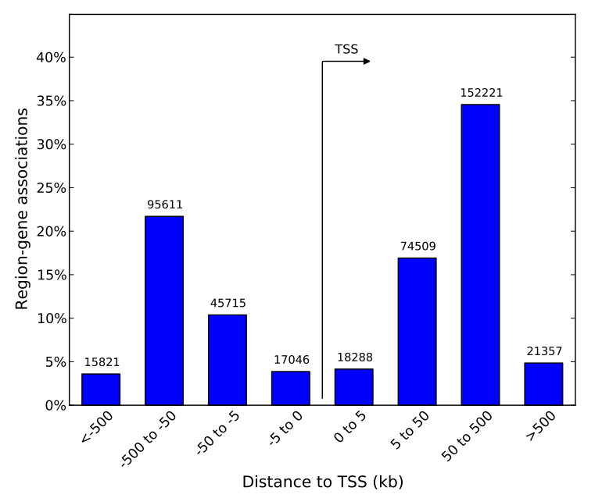
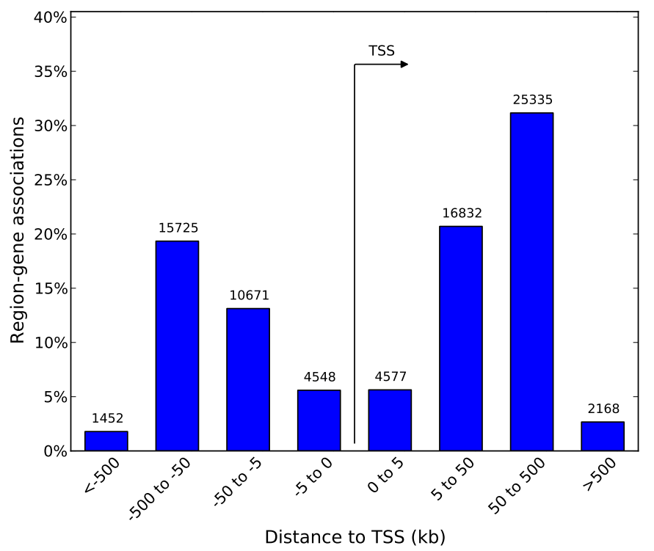
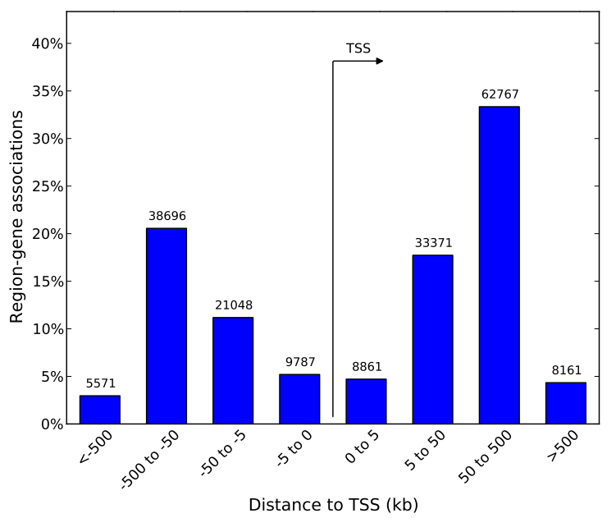
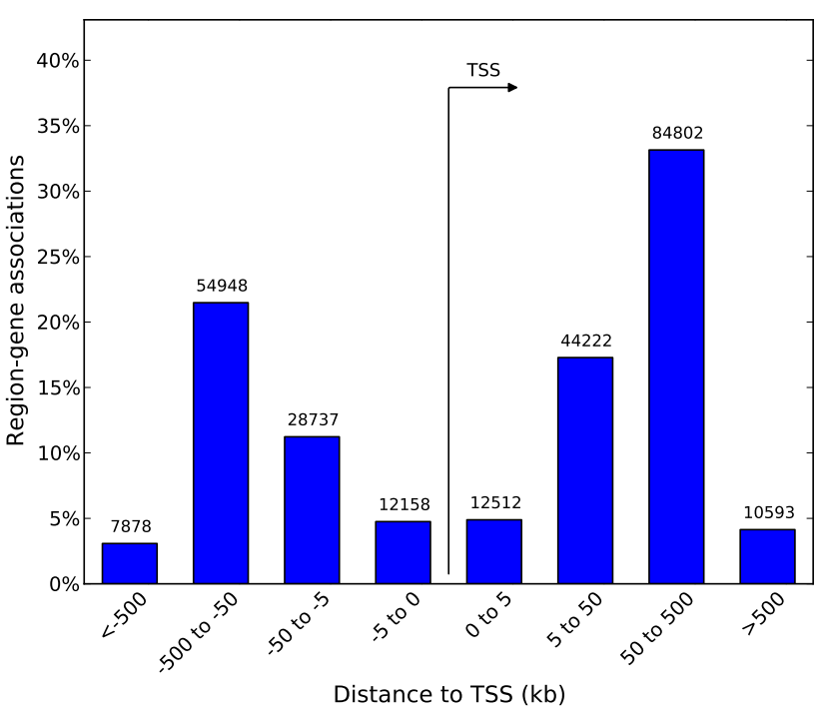
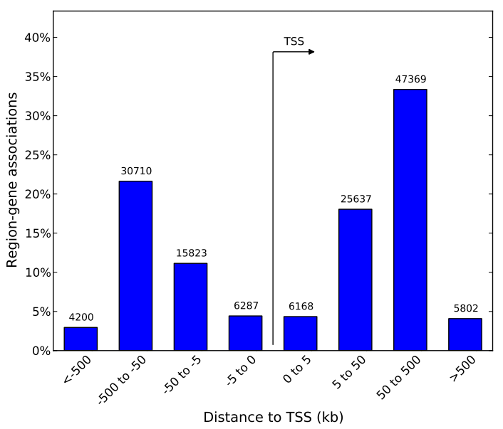
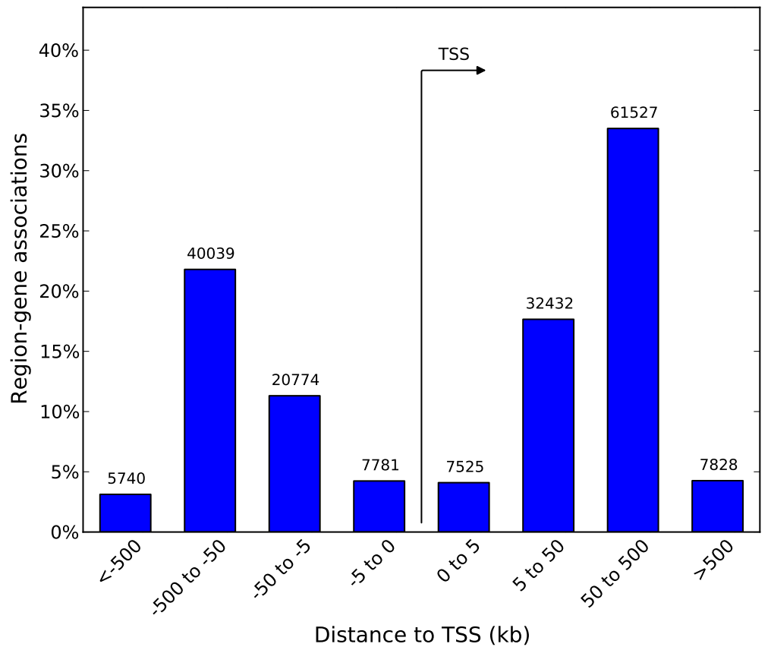
Bladder
Bone Marrow
Brain
Breast
Colon Sig
Colon Trans
Notes:
Results revealed that 5hmc were deficient at TSS and enriched at promoters and gene bodies.

Slide 22
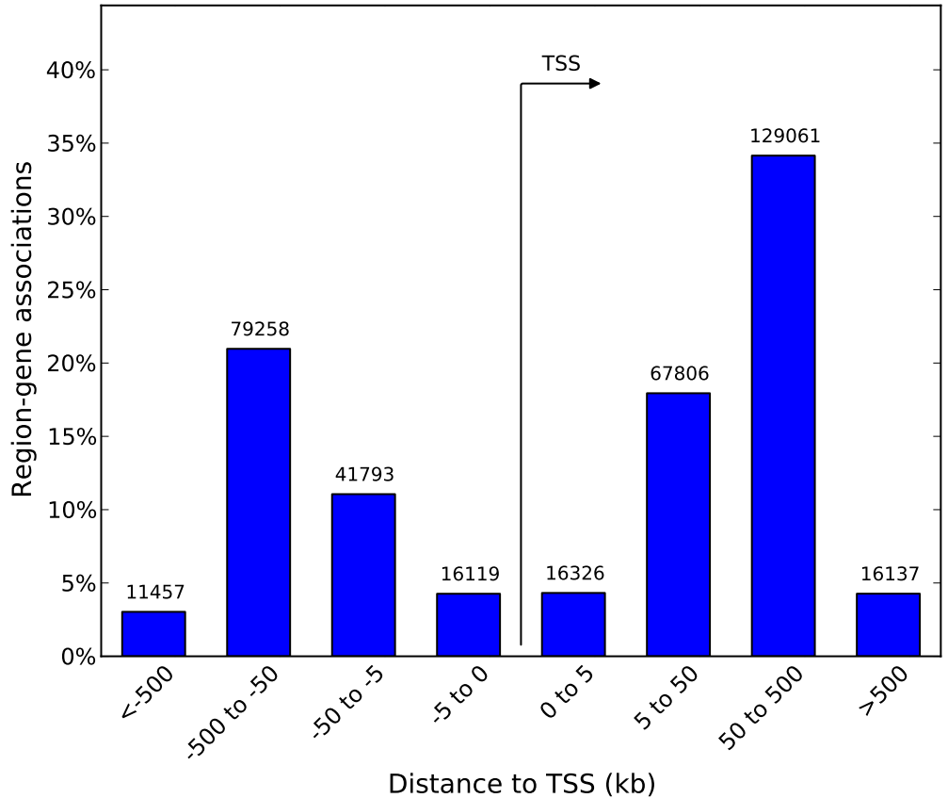
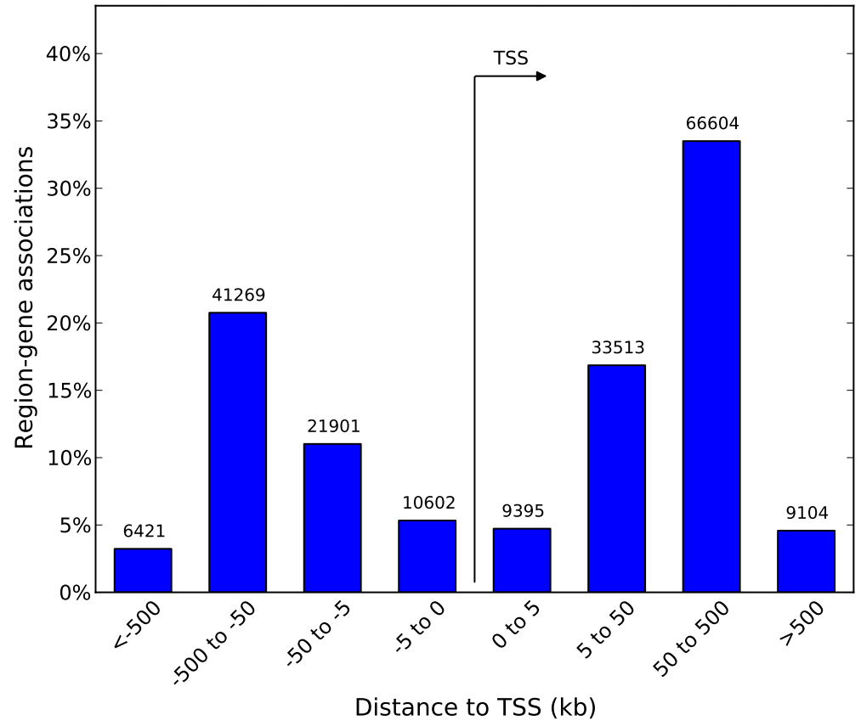
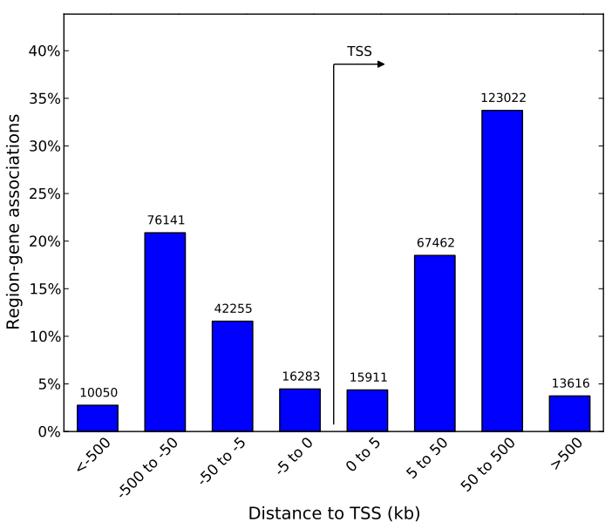
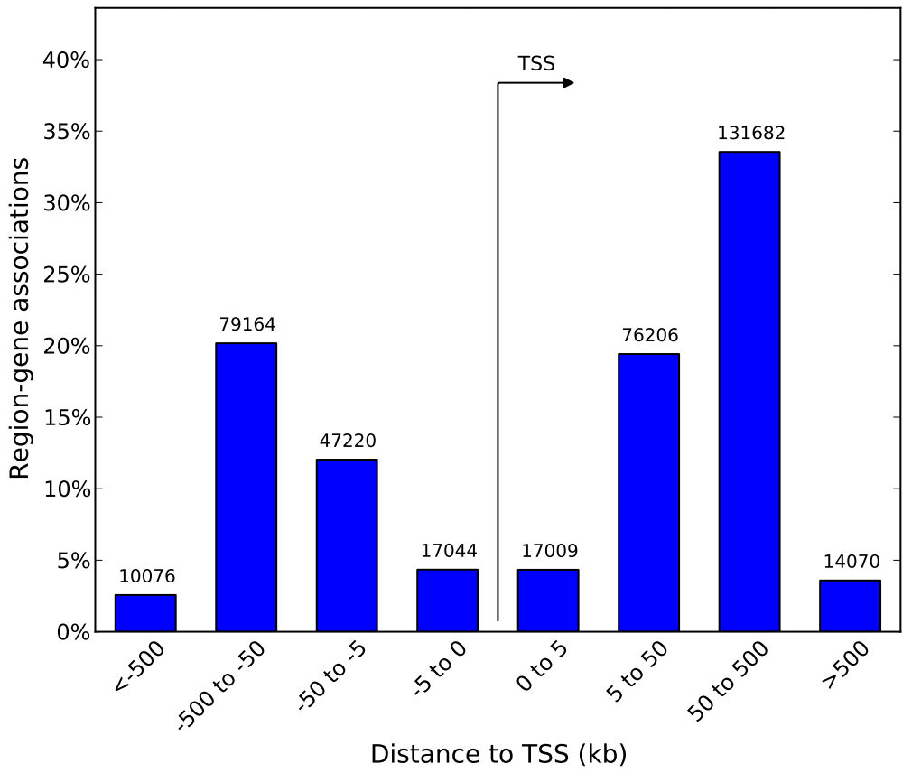
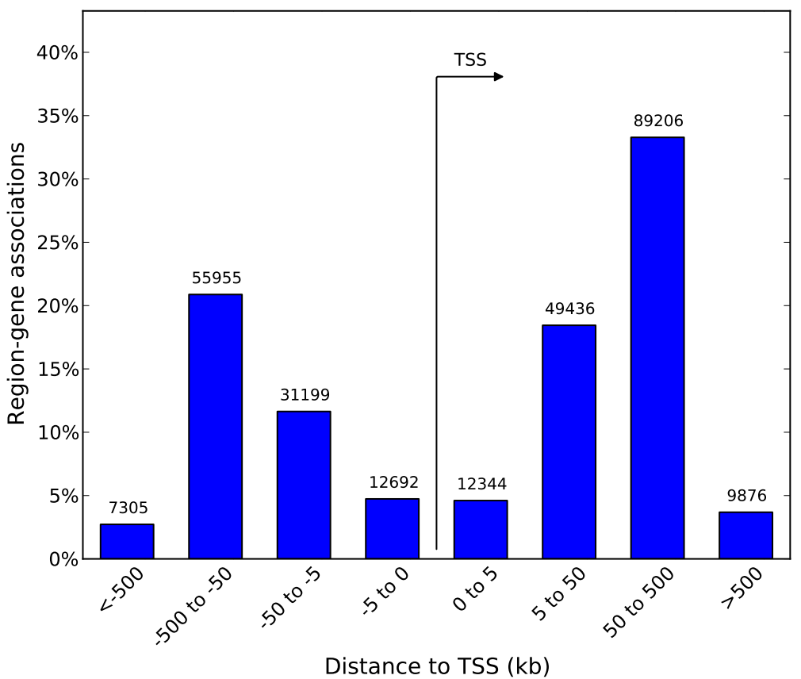
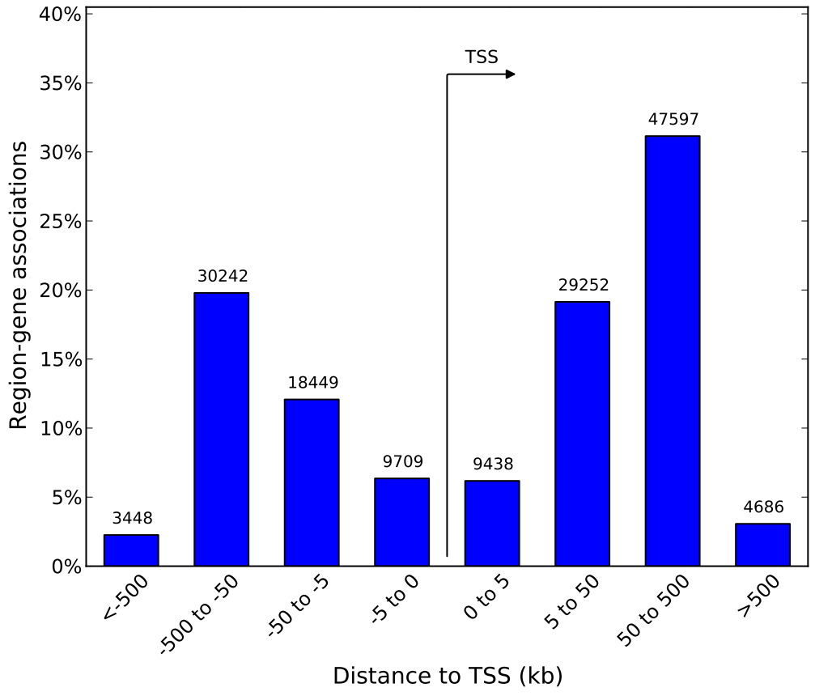
Heart
Hypothalamus
Kidney
Liver
Lungs
Lymph

Slide 23
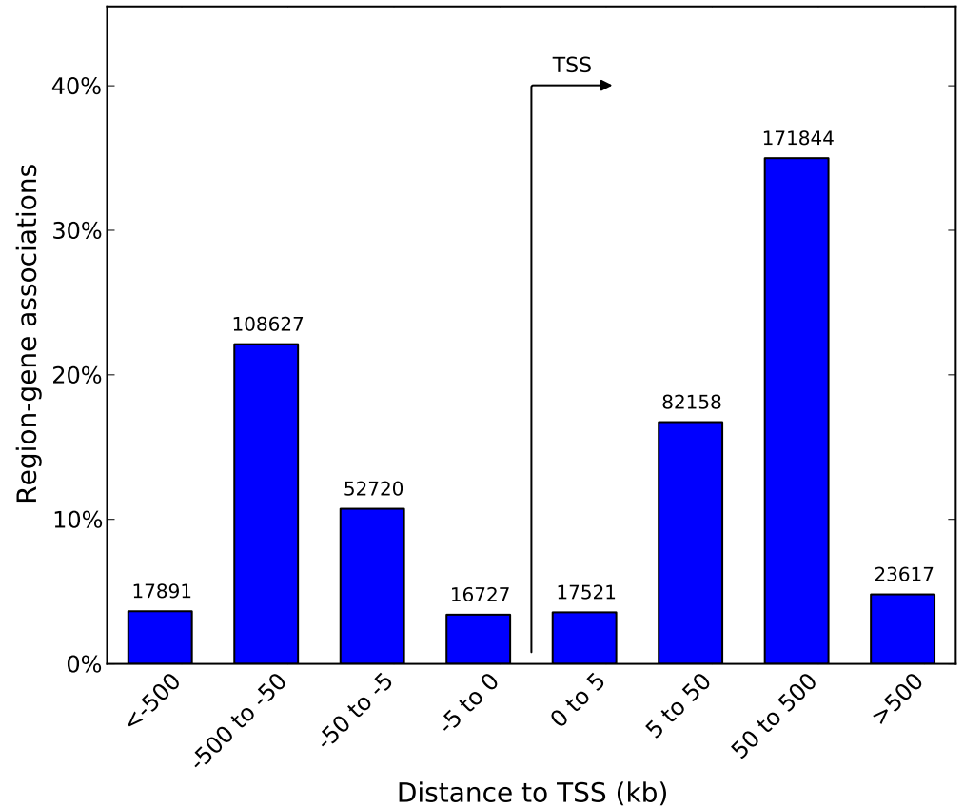
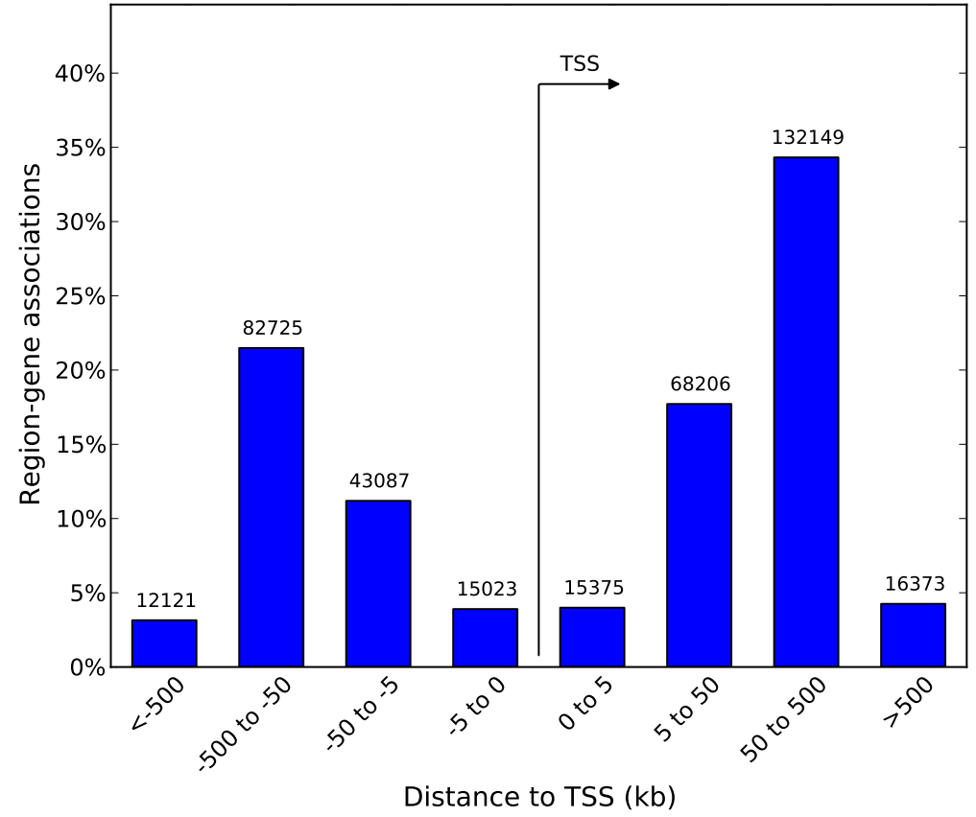
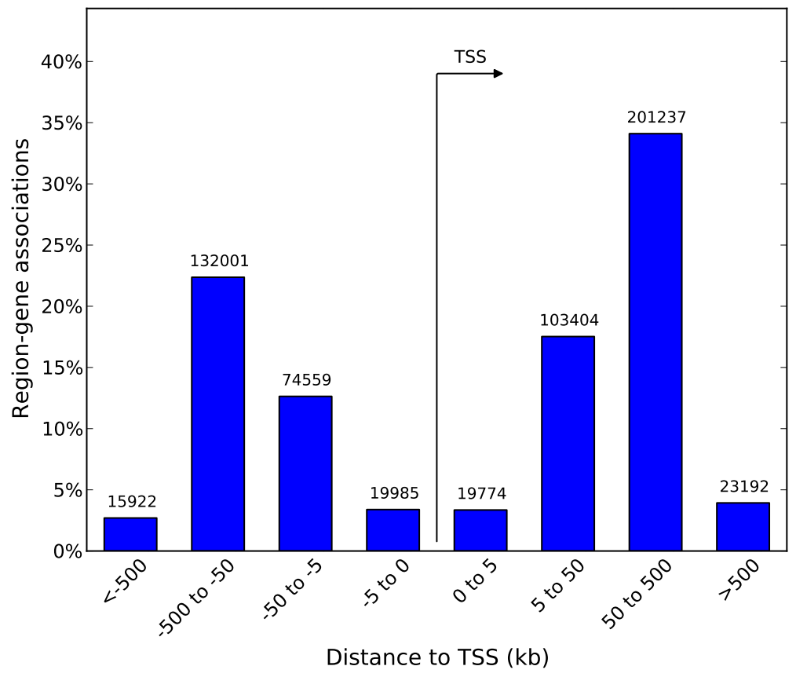

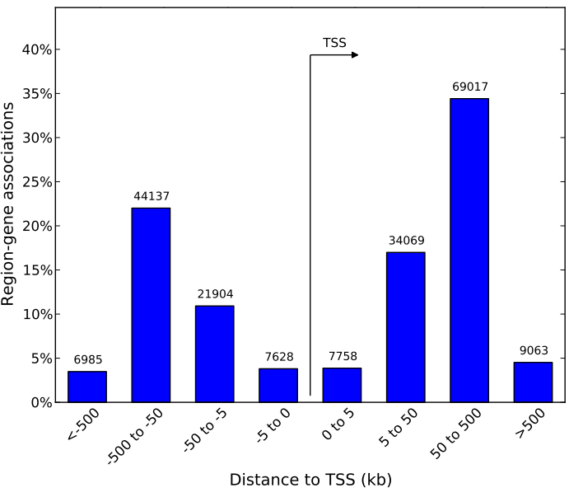
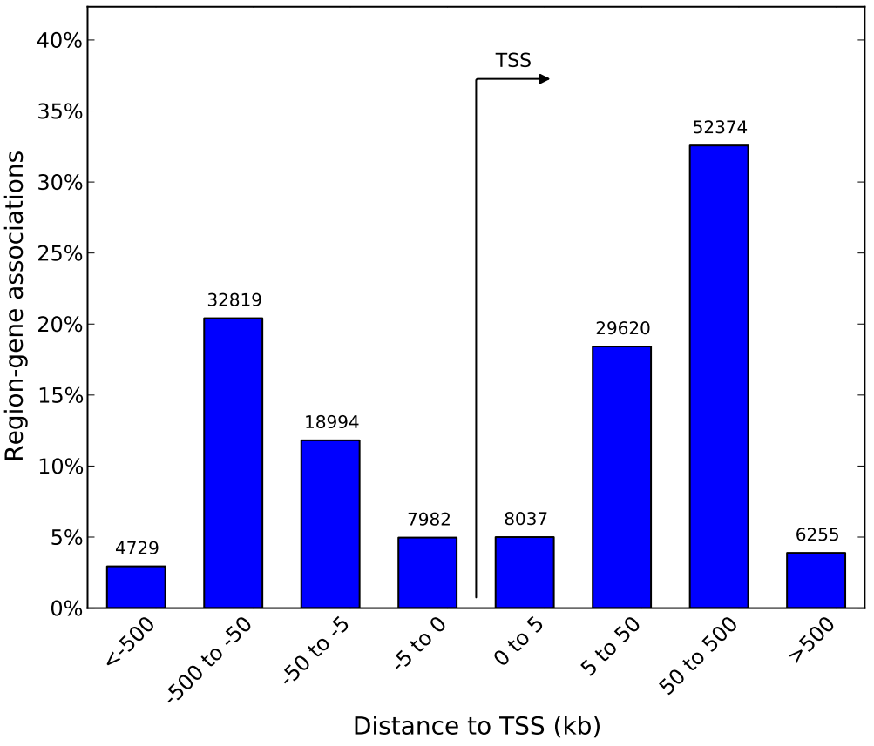
Ovary
Pancreas
Placenta
Skin
Stomach
Testis

Slide 24
Observation of distance mapping
•Proximity to TSS Significance: The -5 kb to 5 kb range emerges as a common hotspot for region-gene associations across tissues. This emphasizes the significance of epigenetic modifications, particularly 5hmC, in the immediate vicinity of the transcription start site (TSS) for gene expression regulation.
•Consistency Across Tissues: While tissues exhibit some variability, the consistent prominence of the -5 kb to 5 kb range underscores its importance across diverse tissues. This suggests a shared regulatory theme in the immediate proximity of TSS for various tissues.

Slide 25
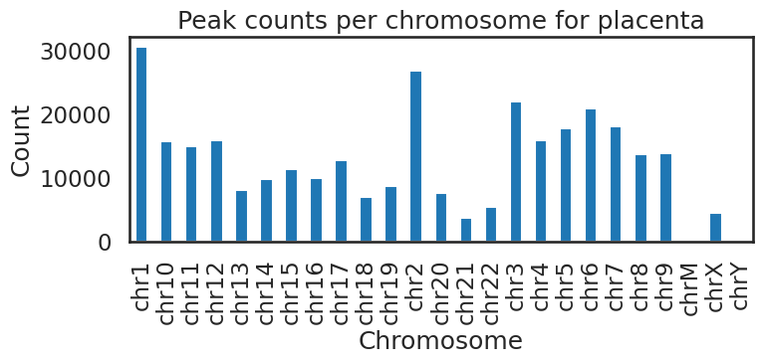
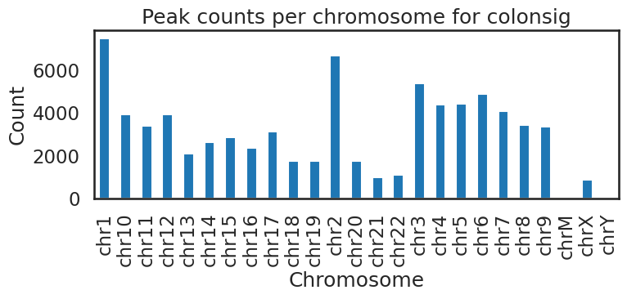
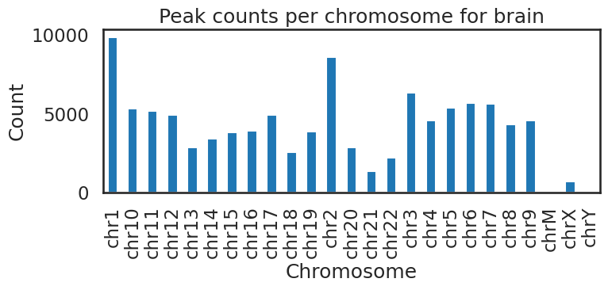
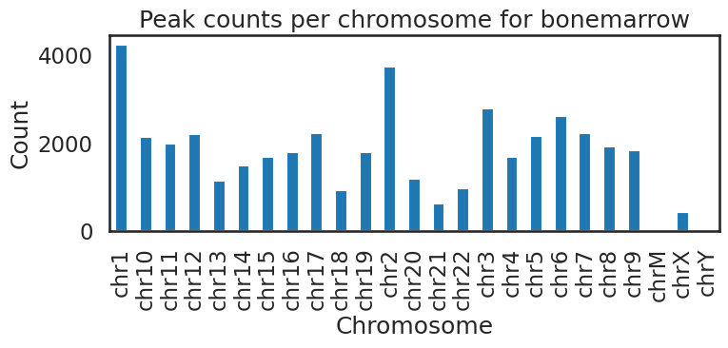
Chromosomal Peak Distribution

Slide 26
Conclusion
Pathways
Peak Counts
Motif
Clustering
5hmc distribution
Distance mapping
Chromosomal peak distribution

Slide 27
References
Cui, XL., Nie, J., Ku, J. et al. A human tissue map of 5-hydroxymethylcytosines exhibits tissue specificity through gene and enhancer modulation. Nat Commun 11, 6161 (2020). https://doi.org/10.1038/s41467-020-20001-w

Slide 28
Thank You.

